Slide 1
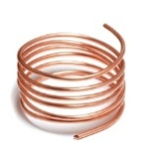
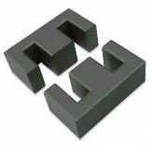
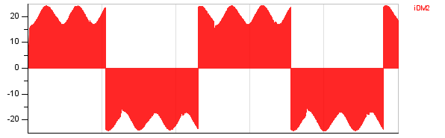
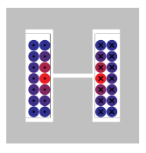
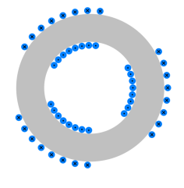
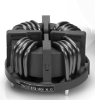
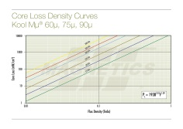
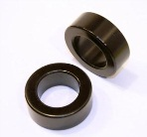
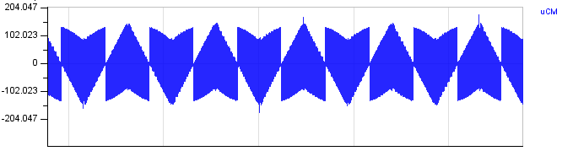
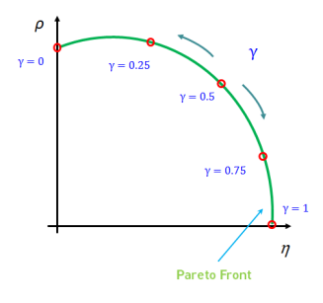
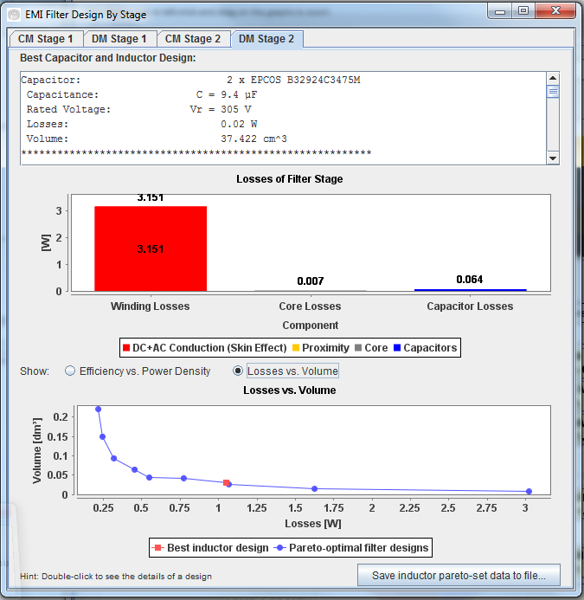
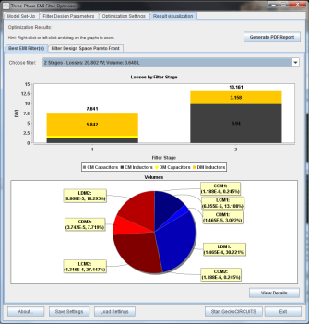
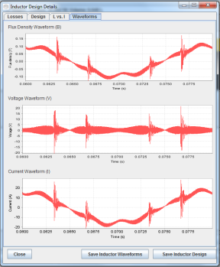
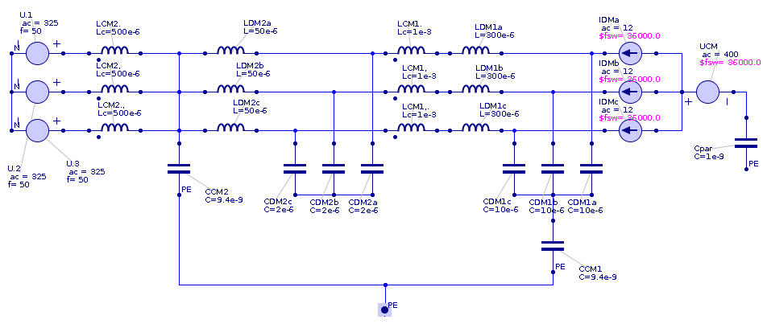
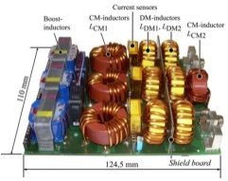
1/150
Gecko Three-Phase EMI Filter Optimizer
FREE Feature Demonstrator Application
Download at http://www.gecko-simulations.com/apec2015
Magnetic simulation
(with thermal model)
Component Design Space
Circuit simulation
DM Current – DM Noise
CM Voltage – CM Noise
Min. Volume
Halfway Compromise
Min. Losses
Optimization Goal
Optimization Algorithm
Multi-Objective Optimized Filter Design

Slide 2
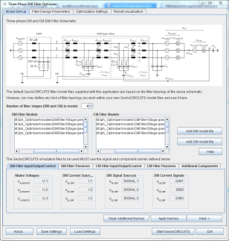
Quick Introduction
The Gecko Three-Phase EMI Filter Optimizer is a free, feature demonstrator Java application build on top of GeckoCIRCUITS and GeckoMAGNETICS for finding the optimal EMI filter design with respect to efficiency and power density within a given design space:
It showcases features in development (e.g. filter optimization)
that will become available in upcoming Gecko-Simulations products;
2) It demonstrates how custom applications can be built on top of
GeckoCIRCUITS and GeckoMAGNETICS, to solve specific real-world
problems in power electronics.
The Gecko Three-Phase EMI Filter Optimizer allows you to define a design space for each filter component, and then using evaluations through simulations and an optimization algorithm, it finds the best design according to your design goal, i.e. your defined compromise between efficiency and power density.

Slide 3
Optimizer Tool for Three-Phase EMI Filters
► Can be used for any three-phase converter topology
(you must build appropriate noise models in GeckoCIRCUITS)
► Multiobjective optimization of an EMI filter for power density
(volume) and efficiency (losses)
► Always calculates set of pareto-optimal designs, and then picks
from this set based on optimization goal
► Gives LC values, attenuation distribution, and components to build
inductors and capacitors from based from a list of real components
in its database

Slide 4
EMI Filter Modeling
● The Optimizer uses a mostly fixed LC-LC filter topology:
● You can select whether CM and DM capacitors are in series or not

Slide 5
Starting the Optimizer
Unzip the downloaded Optimizer package on your computer.
Open the newly created directory.
On Windows and Linux, double-clicking StartOptimizer.jar should start the program. IF this does not work, open a terminal (console), go to the directory and type java –jar StartOptimizer.jar
If you still have problems, please consult the User’s Manual on how to start the program manually.
Within a few seconds, the main optimizer window should open.

Slide 6
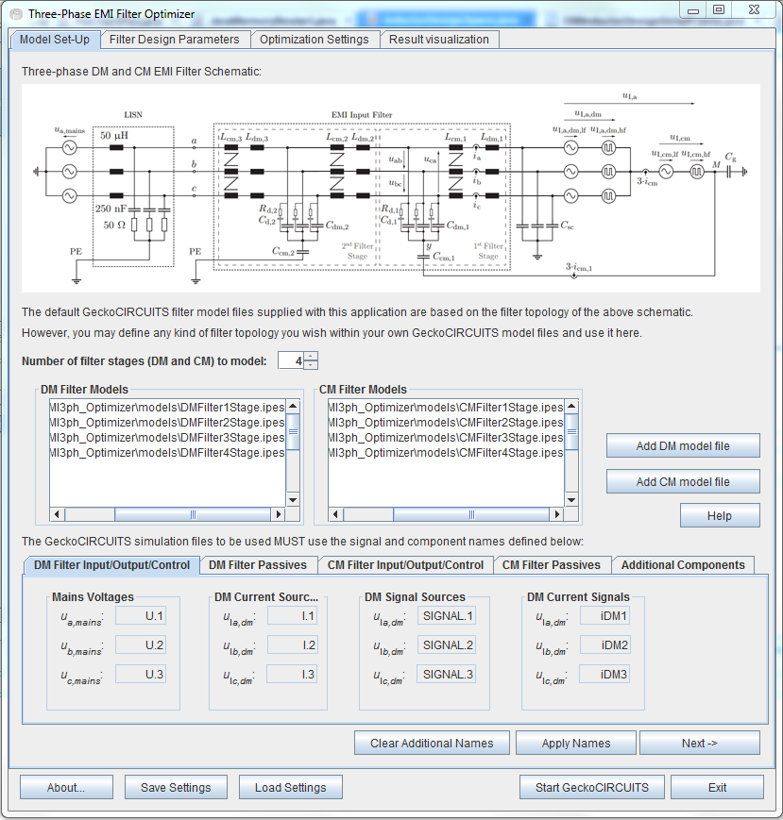
EMI Filter Circuit Simulation Models
Sample models up to 4 filter stages are provided
● First tab of window – model set up
You can add your own models from GeckoCIRCUITS
Circuit simulation models for GeckoCIRCUITS must use the element names shown here
Click “Next” to see all required elements names in simulation models, and also to define additional components (see next slide)
Click “Apply Names” when finished with this screen

Slide 7
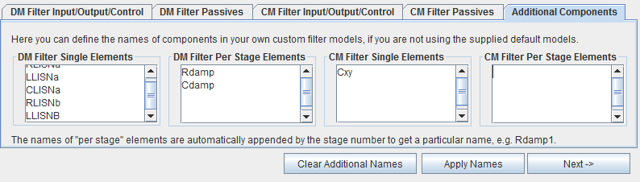
EMI Filter Circuit Simulation Models
● By default, the Optimizer considers only the filtering elements (inductor and
capacitors)
● However, the user can define additional components to use in the models (e.g.
damping elements)
● This is done in the last sub-tab of the Model Set-Up screen
● For more details, see the User’s Manual

Slide 8
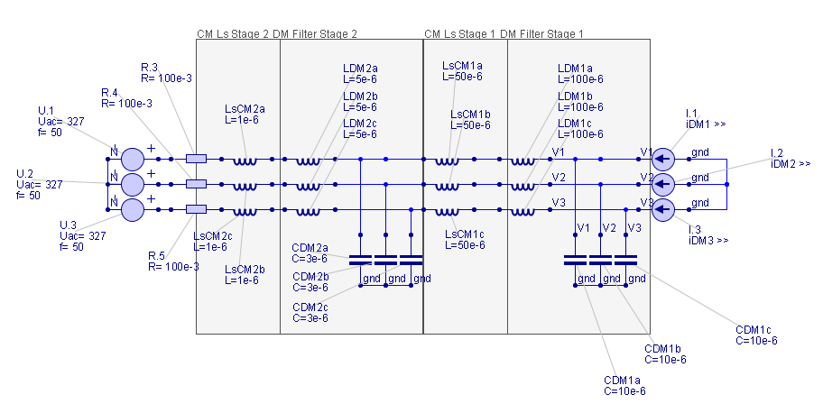
EMI Filter Circuit Simulation Models
● Click “Start GeckoCIRCUITS” and the simulation models will open
● DM noise simulation model:
Converter modelled as current source (all three phases, properly phase shifted!)
CM choke leakage inductances are also accounted for here

Slide 9
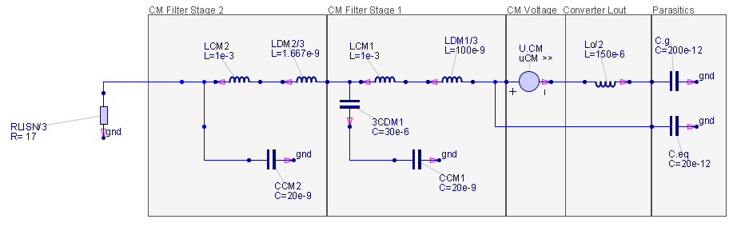
EMI Filter Circuit Simulation Models
Parasitic capacitances
● CM noise simulation model:
Default model is based on buck-type topology, therefore output inductor is present
DM components are also taken into account
For more details on the CM model, please see the User’s Manual

Slide 10
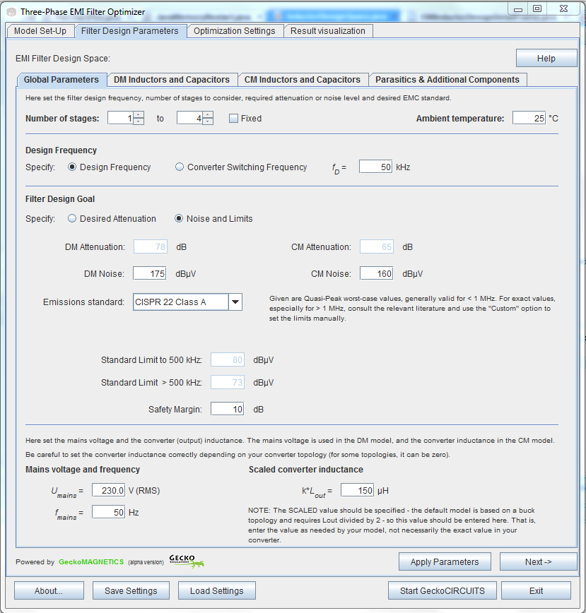
EMI Filter Global Parameters
● “Global Parameters” tab:
Set number of stages to consider
Set filter design frequency directly or specify converter switching frequency
Required DM and CM attenuation can be specified directly, or instead calculated based on noise and emissions standard
Mains voltage and frequency are also input variables

Slide 11
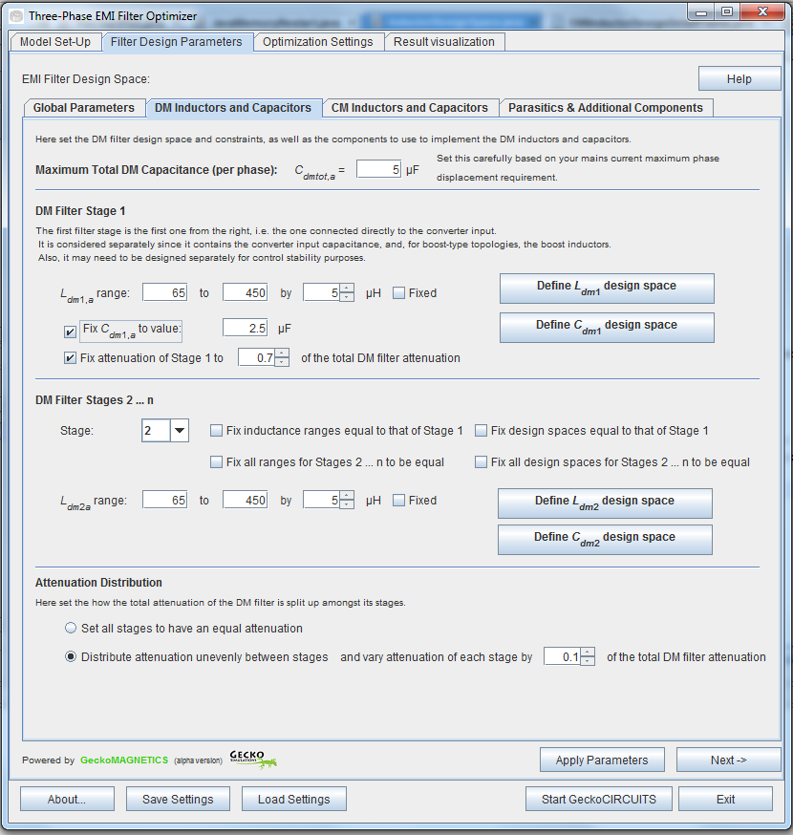
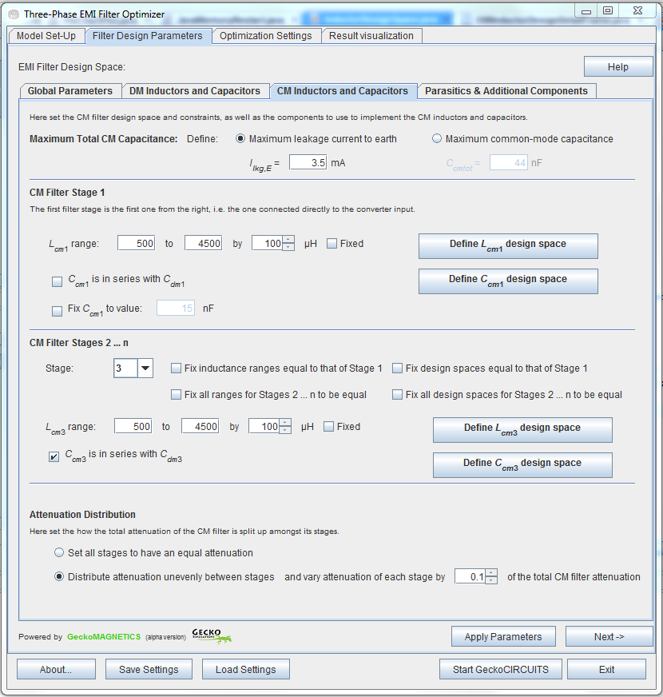
CM and DM Filters
First stage can be considered separately from the rest
Set maximum CM and DM capacitance
Set how attenuation is distributed between stages
Set Inductor and Capacitor Design Spaces
Click here when finished setting all parameters

Slide 12
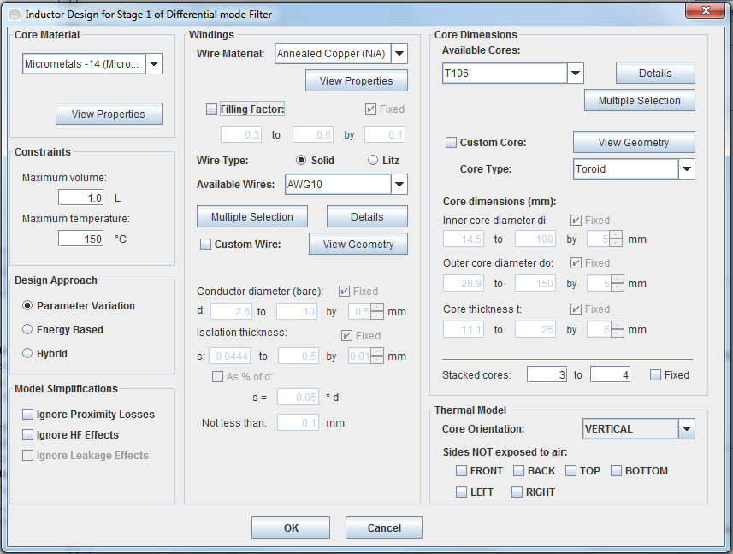
Defining an Inductor Design Space
Cores and wires from the database….
…or custom-defined by the user, with each dimension variable in a range
3 different inductor design approaches (see next slide)
Thermal model considers natural convection only
Model simplifications for faster simulation

Slide 13
Defining an Inductor Design Space
● Toroid and EE cores (latter for DM inductors only)
● Round solid and litz wires
● Three design approaches for inductors:
- Parameter Variation: tries all values of design parameters in user defined ranges
- Energy Based: uses the core geometry coefficient and area product when
selecting which core to use for the inductor design (quickly rejects cores which
are too small, but does not necessarily explore the entire design space)
- Hybrid: combines the two approaches above (searches with a subset of the user-
defined ranges arrived at through the use of the energy-based approach) –
combines quick rejection of very unsuitable designs with a more detailed search
of the design space

Slide 14
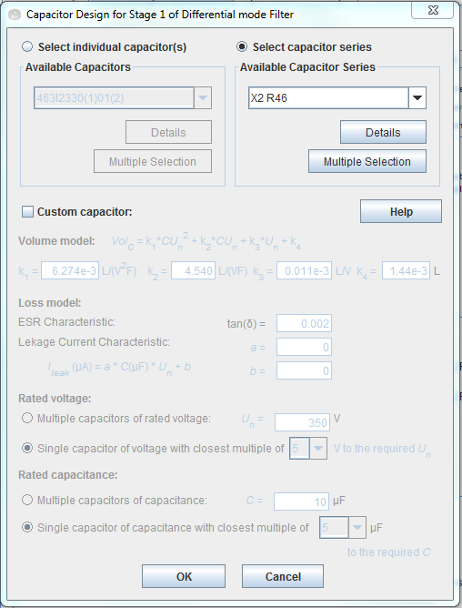
Defining a Capacitor Design Space
Can select individual capacitors from the database….
…or can select capacitor series from the database, where each series contains capacitors of various capacitance values
Alternatively, a custom capacitor model can be defined

Slide 15
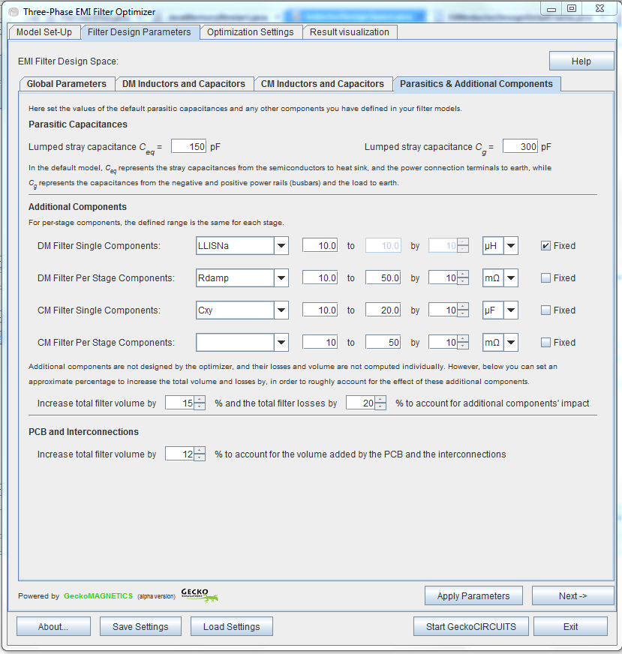
Parasitics and Additional Components
Specify value of parasitic capacitances for CM noise model
Specify value ranges of user-defined additional components, if any
Approximately account for volume of PCB and interconnections

Slide 16
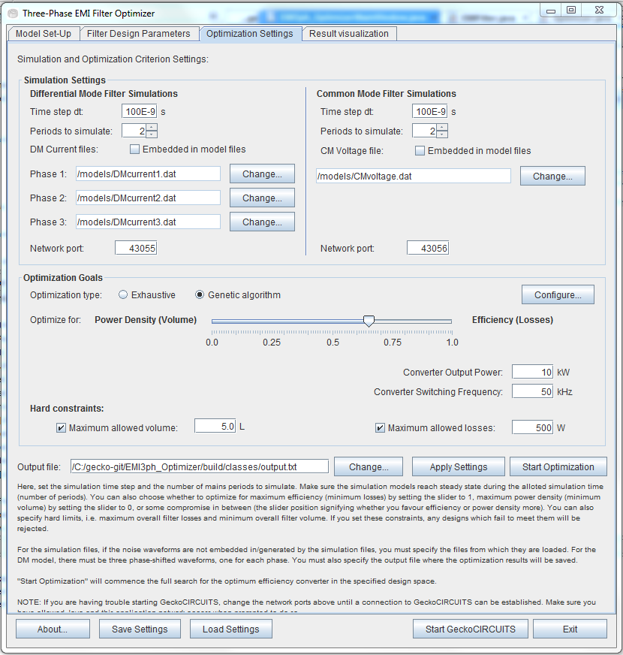
Optimization Settings
Simulation length and time-step
Files with noise waveforms (DM current and CM voltage)
Choice between two optimization algorithms (see Manual for details)
Select optimization goal:
0 – max. power density
1 – max. efficiency
0.5 – half-way compromise
(values from 0 – 1 are possible in increments of 0.01)
This button starts the optimization process

Slide 17
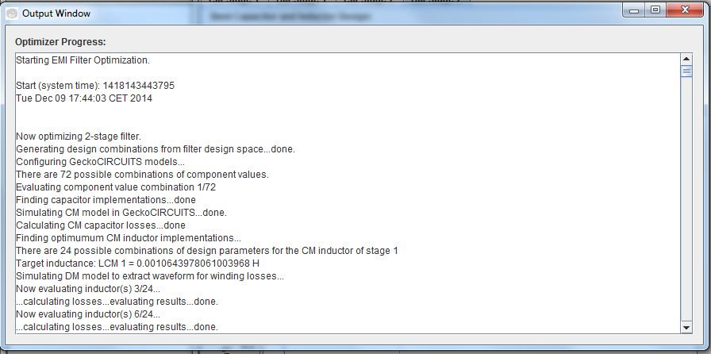
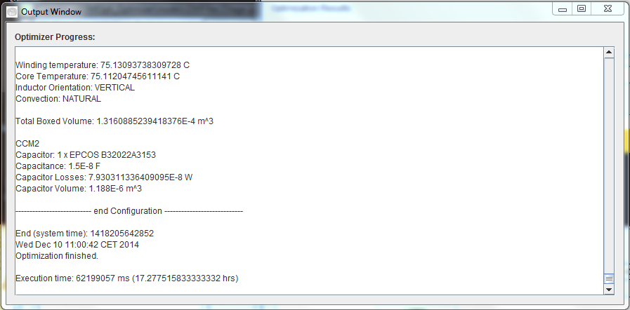
Optimization Progress
Output Window opens
Shows progress…
Shows message when finished

Slide 18
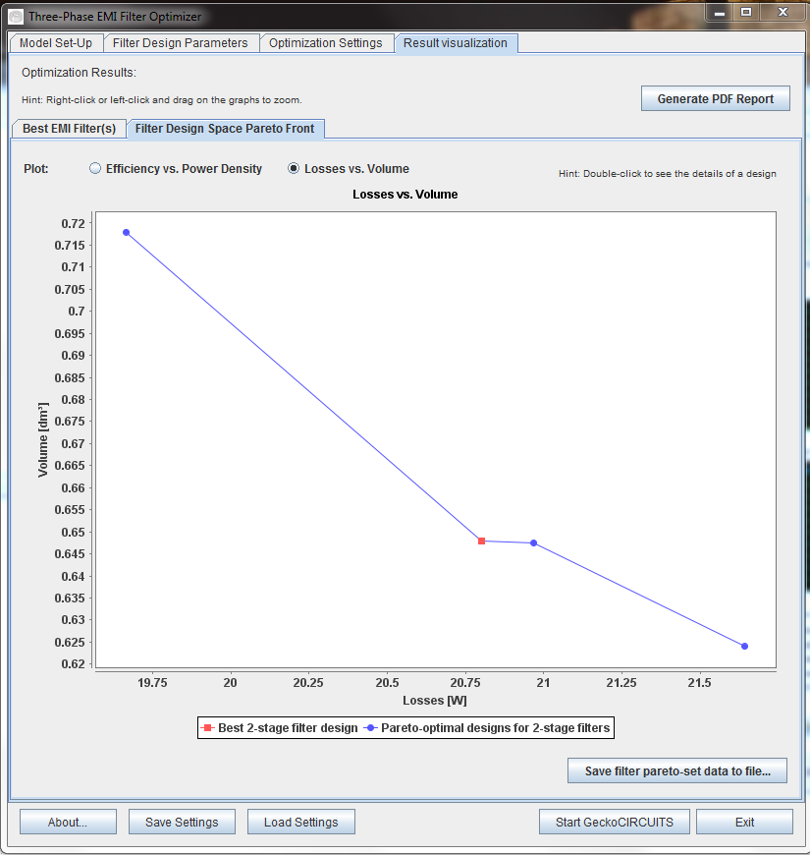
Results: EMI Filter Designs Pareto Front
Can select how to display the plot
Move mouse over any point to see summary of design, double-click to open a window showing detailed results
Best filter design with respect to the selected design goal is highlighted
The pareto front data can be saved to a file

Slide 19

Results: Best EMI Filter Designs
Best design (based on optimization goal) for each number of stages is given here
Can save the optimization results as a PDF file
Loss breakdown by stage and component
Volume breakdown by stage and component
Click this button to view details of the filter design stage-by-stage

Slide 20
Detailed EMI Filter Results
Detailed results for each filter stage
Details for the capacitor and inductor design for this stage (components used, dimensions, exact losses and volumes)
Loss breakdown for this stage
Pareto front of the design space for this stage’s inductor, showing highlighted the selected inductor design (according to the set optimization goal)
Double-click on a point to see the details of the inductor design
Inductor pareto front data can be saved to a file

Slide 21
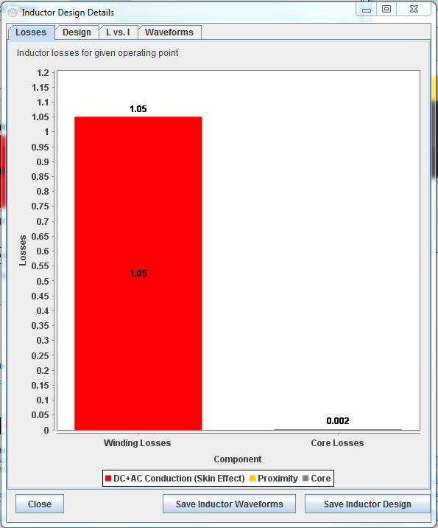
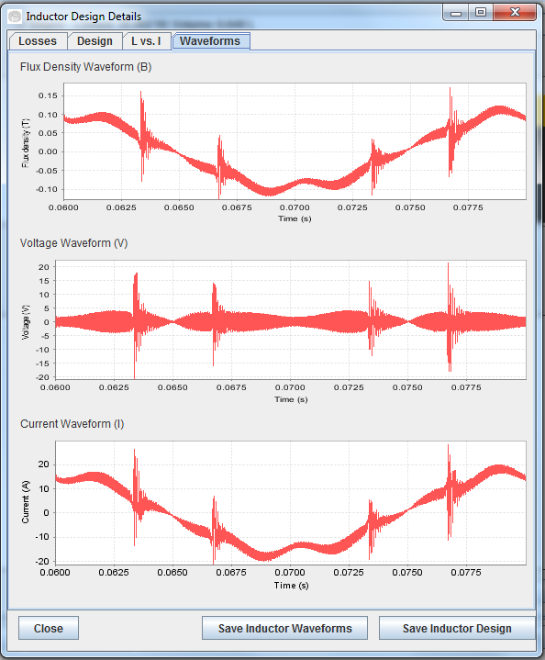
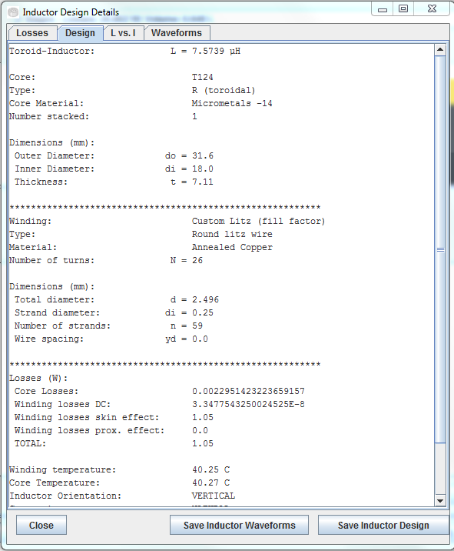
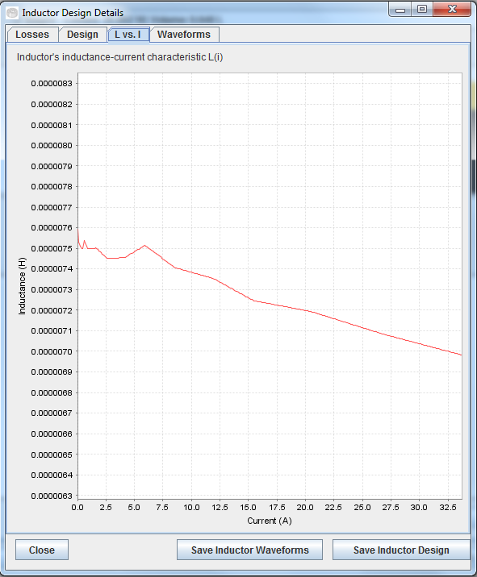
Detailed Inductor Results
Detailed results for each inductor in the pareto front
Losses for one inductor
Detailed design description
L vs. I characteristic
Inductor waveforms
can be saved to file
Inductor design can be saved for loading into GeckoMAGNEITCS

Slide 22
User’s Manual
Before using the program, and for all other details, please read the User’s Manual!

Slide 23
Gecko-Simulations AG
Physikstrasse 3, 8092 Zurich,
Switzerland
contact@gecko-simulations.com

